Slide 1

Booz Allen Hamilton Tech excellence
Group 1 – Zack Castaneda, Marsha Enten, Jay Gosson, Christa Jordan
October 2020

Slide 2
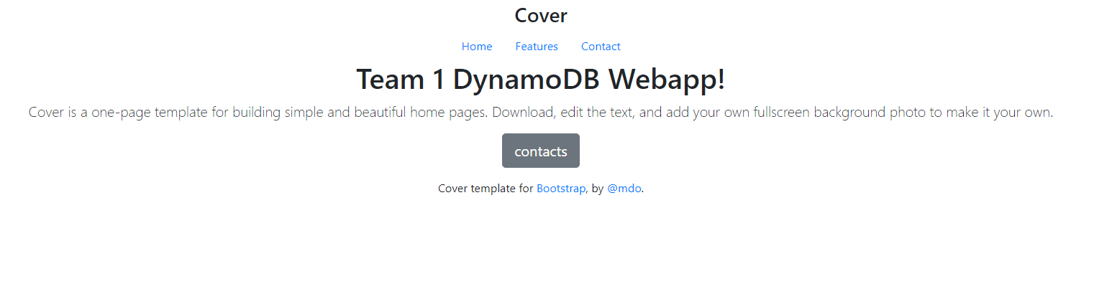
Project overview
A simple pipeline that will deploy a web application to interface with a no-SQL database of contacts and display the contents

Slide 3
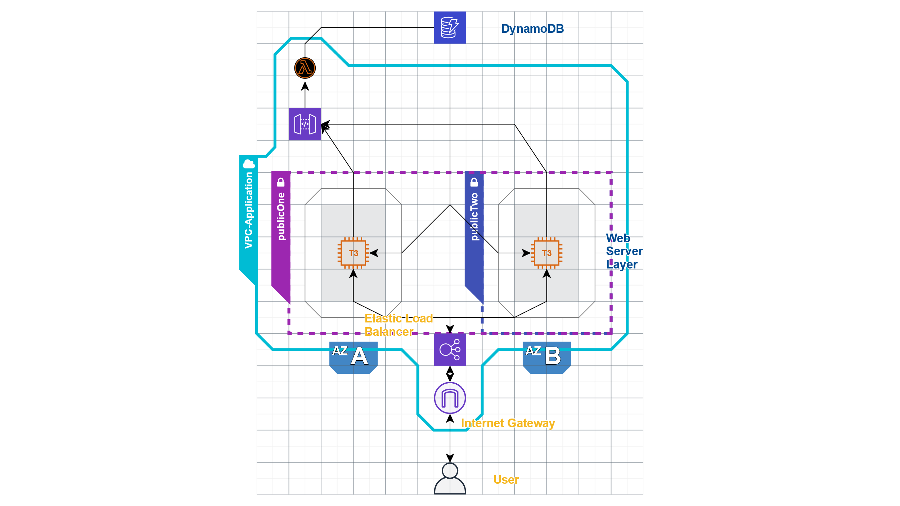
Architecture

Slide 4
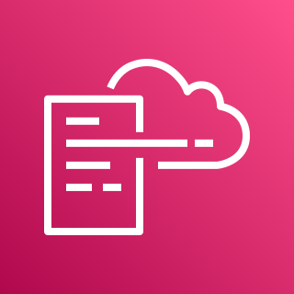

Tools - Infrastructure as code
Cloud Formation used to define:
VPC (Virtual Private )
Public and Private subnets
Internet Gateway
Route Tables
Security Groups
EC2 Instances
Elastic Load Balancer
AWS CloudFormation
Stacks

Slide 5
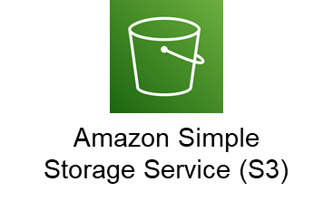

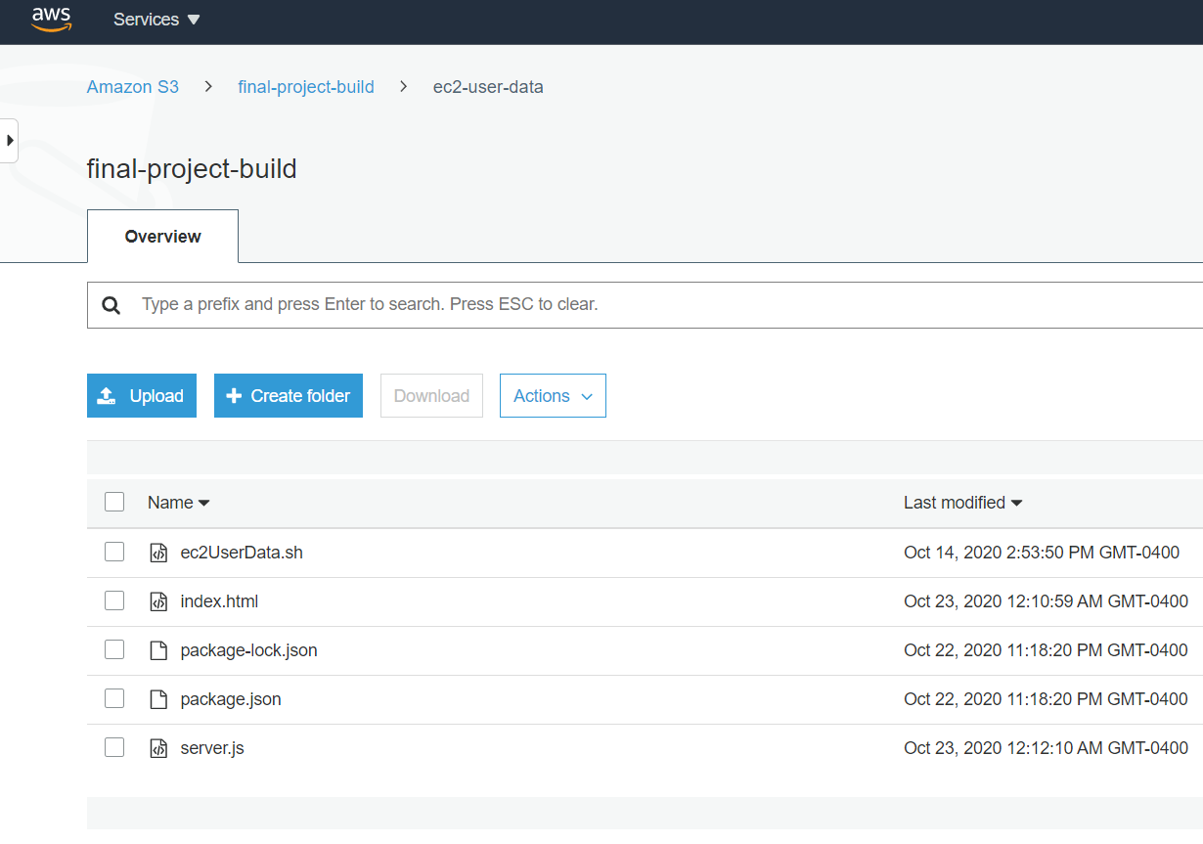
Tools - Web Application
JavaScript web application, stored in S3 bucket and accesses DynamoDB data via API Gateway
Nodejs
NPM
Expressjs
Pm2
Bucket with
objects

Slide 6
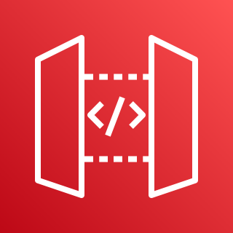
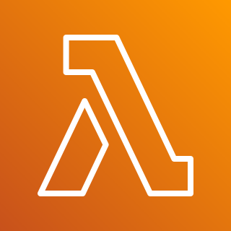
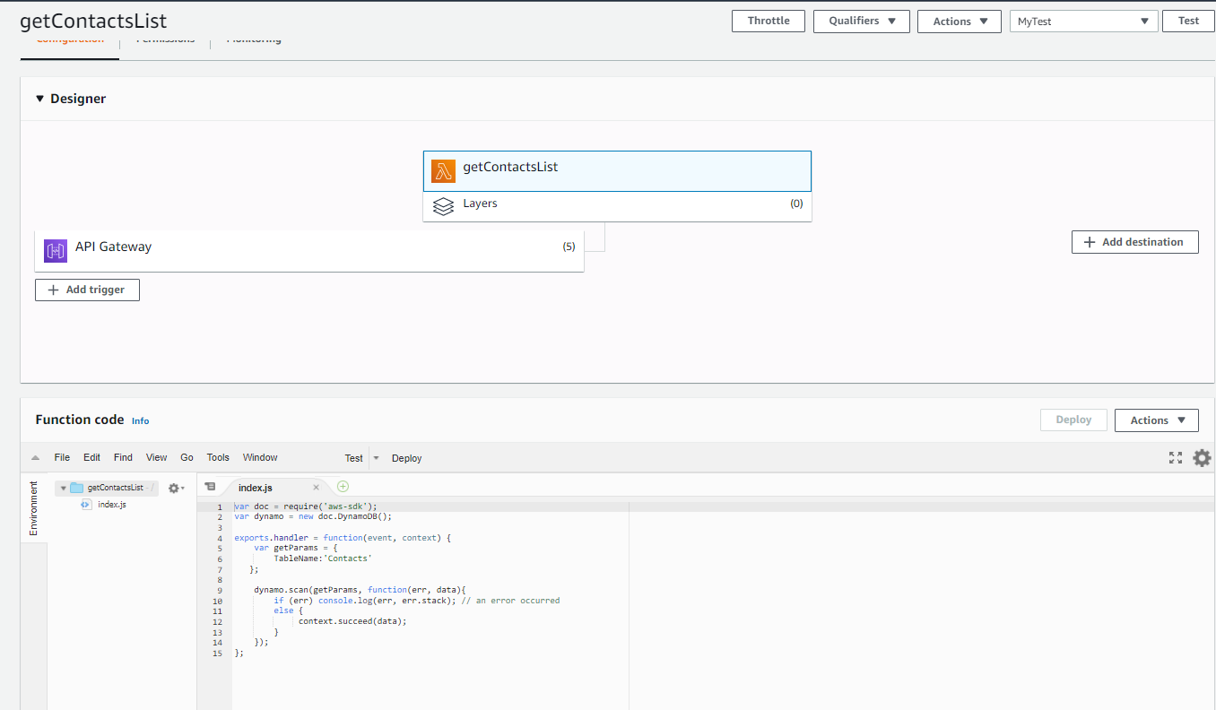

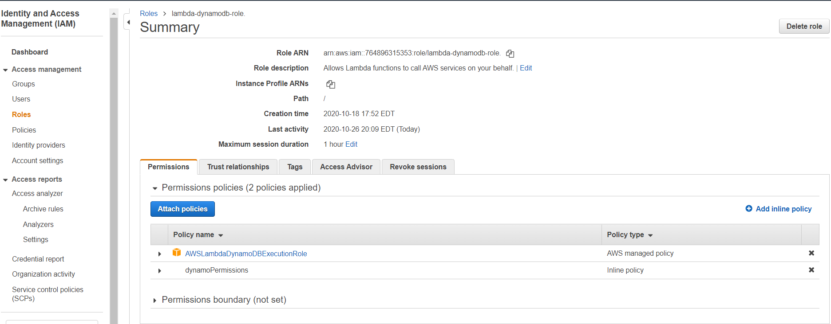
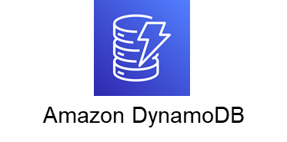
Tools - API GATEWAY & LAMBDA
The API Gateway and Lambda functions were used to extract data from the DynamoDB
A role Lambda-DynamoDB-Role was applied to the API Gateway in order to allow data to be securely accessed.
Amazon API Gateway
AWS Lambda
Lambda function

Slide 7
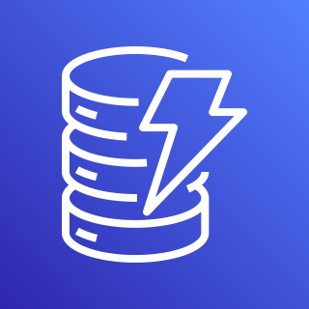

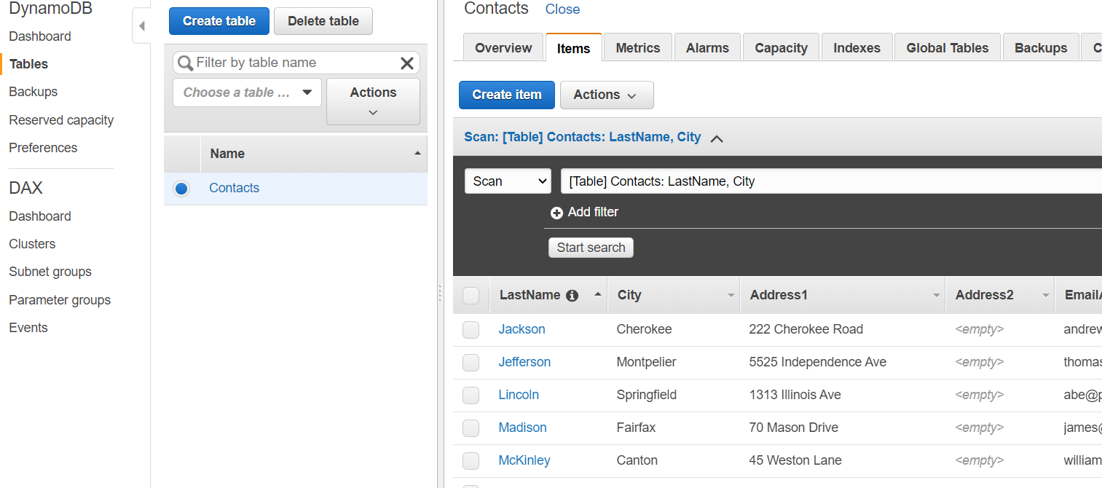

Tools - Data Management
Database management was done via DynamoDB, a noSQL solution. A table called Contacts was populated with items, with the Partition Key LastName
Amazon DynamoDB
Table: Contacts
Items (Partition Key: LastName)

Slide 8
Challenges and Lessons Learned
CURL, was a useful tool to test the API endpoint
Configuring gateways to allow public access required security settings
Trouble using user data to automate installation of packages on instance
Resulted in creating an AMI combined with a startup script for the webapp instead of using user data
SSH into ec2 instance—getting files from s3 bucket to ec2
Security groups configured to accept traffic on correct port
Cloudformation
Troubleshoot changes to template that changed IAM privileges
Challenge in getting data from api call to display on the page

Slide 9
demo
Cloudformation Resources and outputs--Jay
WebApp--jay
Curl of API--Zack

Slide 10
Questions & answers

